Slide 1

36th ASC conference student competition
Manufacturing and Mechanics Lab
Haotian Feng, Sabarinathan P. Subramaniyan, H. R. Tewani, Guanjin Yan
University of Wisconsin-Madison, Madison, WI, USA
36th ASC Technical Conference Sept 20th, 2021

Slide 2
GENERAL APPROACH SUMMARIZATION
Stepwise
Regression
Given Data
Feature Selection
Resources from paper
Feature Validation
there could be many optimal solutions.
Linear Regression with cross-terms
Genetic Algorithm
Validate prediction model
Train-Test Split
Find best prediction model
Find optimal solution

Slide 3
FEATURE SELECTION – STEPWISE REGRESSION
Different order of features and cross terms
AIC, P-value, R-squared
Given Data
Z-transform
Normalization
Stepwise Regression
Feature Selection
In order to effectively determine the max order of cross terms considered for this problem, we conder max order from 0 to 3 in stepwise regression analysis.
Stepwise can give us a general idea of related features. However, we cannot fully rely on the extracted features from stepwise regression. In this project, we also use LASSO regression model to aid us in feature selection. We further updated the selected feature with our knowledge and the conclusions from provided papers.
The final regression model is determined from many test iterations. We test for different regression models, understand how each feature is contributing to the prediction and finally find the best model. (For this project we use up to 5th order)

Slide 4
FACE-SHEET CONSOLIDATION
During facesheet consolidation, resin from the prepreg gets squeezed out in the bondline area.
Bondline thickness is quite thin – therefore, the pressure gradient through the thickness = 0.
Hence, core pressure acting on the bondline will be equal to the vacuum pressure.
The autoclave pressure (P_{a}) and the vacuum pressure (P_{v}) will facilitate the facesheet consolidation and the degassing process.
We used z-transformation to normalize all the inputs.
Co-curing Process
Temperature Cycle
Vacuum Pressure (P_{v}) Cycle
Autoclave Pressure (P_{a}) Cycle
(P_{a})
Governing equation from ML model:
Volume fraction = (w₁*P_{a}) – (w₂*P_{v}) + 57.8
where P_{a} = normalized autoclave pressure
P_{v} = normalized vacuum bag pressure
(P_{v})
Prepreg
Adhesive
(P_{c})
Core Material

Slide 5
BONDLINE POROSITY
During facesheet consolidation, the squeezed-out resin from the prepreg enters into the bondline.
The volume of the squeezed out is lower than the adhesive volume – higher porosity in the squeezed-out resin will have lesser impact on the bondline porosity.
If the squeezed-out resin gels before the adhesive, it might result in higher bondline porosity.
Co-curing Process
Temperature Cycle
Vacuum Pressure (P_{v}) Cycle
Autoclave Pressure (P_{a}) Cycle
The viscosity of the adhesive and the resin decrease to the lowest point during the Ramp – I and Temperature Dwell – I.
After TD – I, the viscosity slowly increases to reach the gelation point – diffusion induced growth of voids and curing shrinkage of voids take place. Therefore, Heat rate – II becomes a vital parameter that influences the effective porosity.
Delaying the gelation process would decrease the bondline porosity.

Slide 6
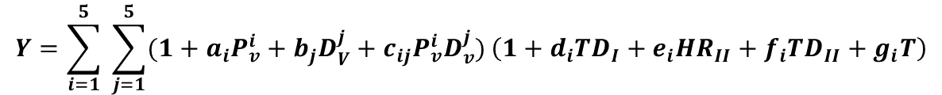
BONDLINE POROSITY
Governing equation from ML model:
Bondline Porosity (Effective porosity) :
where P_{v} = normalized vacuum bag pressure,
D_{v} = normalized vacuum duration,
TD_{I} and TD_{II} = normalized temperature dwell I and II, respectively,
HR_{II} = normalized heat rate – II, and
T = normalized total time
$$Y=\sum_{i=1}^{5}{ \sum_{j=1}^{5}{(1+a_{i}P_{v}^{i}+b_{j}D_{V}^{j}+c_{ij}P_{v}^{i}D_{v}^{j})}\left(1+d_{i}{TD}_{I}+e_{i}{HR}_{II}+f_{i}{TD}_{II}+g_{i}T\right)}$$
Tayler Expansion of P_{v} D_{v}

Slide 7
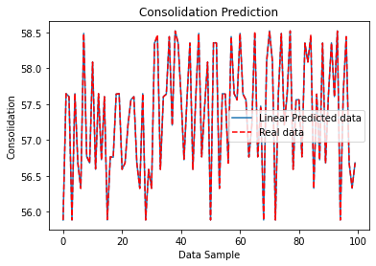
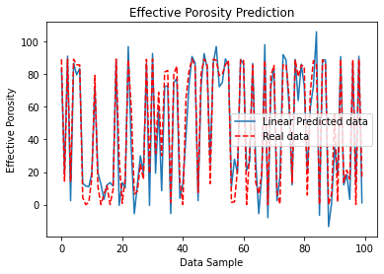
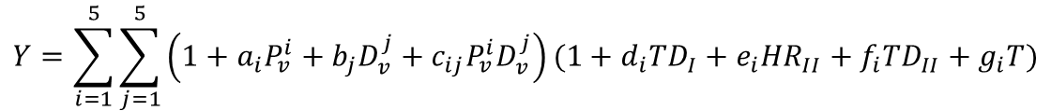

PREDICTION RESULTS
The training and validation process is based on 80%-20% random split. Regression model is trained with 80% randomly selected data and the remaining 20% are used for testing.
To visualize how our regression model performs, we randomly select 100 samples from our test set and plot the predicted value against real value.
$$Y=\sum_{i=1}^{5}{\sum_{j=1}^{5}{\left(1+a_{i}P_{v}^{i}+b_{j}D_{v}^{j}+c_{ij}P_{v}^{i}D_{v}^{j}\right)(1+d_{i}{TD}_{I}+e_{i}{HR}_{II}+f_{i}{TD}_{II}+g_{i}T)}}$$
$$Y=0.72P_{a}−0.31P_{v}+57.38$$
*Consolidation and Effective Porosity are linked by the Vacuum Pressure.

Slide 8
OPTIMIZATION
 | Heat Rate 1 [C/min] | Ramp 1 Duration [min] | Temperature Dwell 1 [min] | Heat Rate 2 [C/min] | Ramp 2 Duration [min] | Temperature Dwell 2 [min] | Vacuum Pressure (*Patm) [Pa] | Vacuum Start Time [min] | Vacuum Duration [min] | Autoclave Pressure (*Patm) [Pa] | Autoclave Start Time [min] | Autoclave Duration [min]
MIN | 1 | 22.5 | 60 | 0 | 0 | 0 | 0.01 | 1 | 120 | 2 | 1 | 120
MAX | 4 | 90 | 120 | 4 | 67 | 120 | 1 | 80 | 336 | 4 | 80 | 336
For this project, we are assuming the optimization value exists within the given ranges. We follow the pre-assumptions given from data, including:
For one step heat map, final temperature is fixed to be 160C and duration to be 120min.
For two step heat map, temperature after first step is 90C and temperature after second step is 157C.
During optimization, values of each input parameter are not allowed to exceed the min-max range.

Slide 9
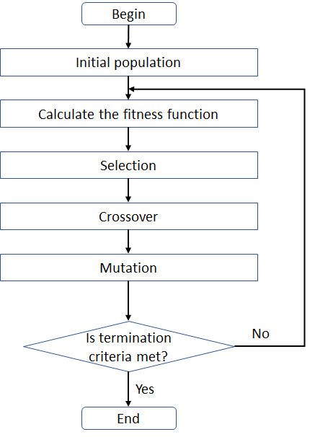

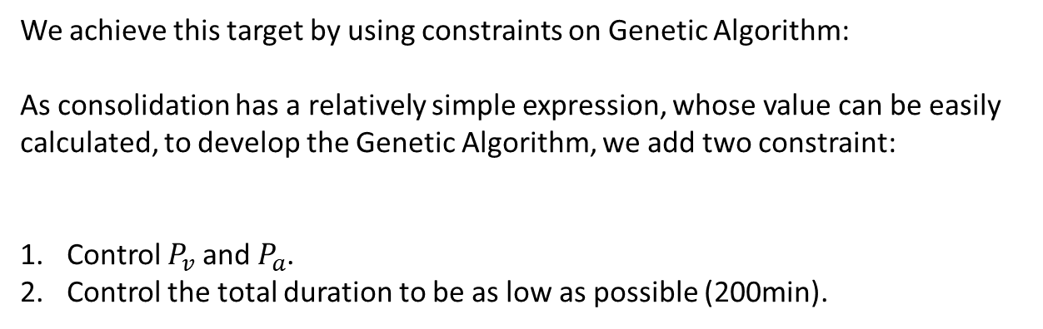
OPTIMIZATION – GENETIC ALGORITHM (stochastic optimization)
Genetic Algorithm is a search heuristic from the theory of natural evolution.
Crossover-Mutation process will continue until stopping criterion is met.
Fitness function F is the trained effective porosity regression model, which predicts the effective porosity and we want it to be as low as possible (zero).
Optimization targets: Higher Consolidation, Lower Porosity, Lower duration.
We achieve this target by using constraints on Genetic Algorithm:
As consolidation has a relatively simple expression, whose value can be easily calculated, to develop the Genetic Algorithm, we add two constraint:
Control $P_{v}$ and $P_{a}$.
Control the total duration to be as low as possible (200min).
$$Y=0.72P_{a}−0.31P_{v}+57.38$$

Slide 10
OPTIMIZATION – Results and Conclusion
 | Heat Rate 1 | Ramp 1 Duration | Temperature Dwell 1 | Heat Rate 2 | Ramp 2 Duration | Temperature Dwell 2 | Vacuum Pressure | Vacuum Start Time | Vacuum Duration | Autoclave Pressure | Autoclave Start Time | Autoclave Duration | Total Duration | Effective Porosity | Consolidation
2-Step | 2 | 44 | 85 | 2 | 28 | 40 | 0.01 | 27 | 172 | 4 | 57 | 142 | 200 | 0.003 | 58.53
1-Step¹ | 2 | 80 | 120 | 0 | 0 | 0 | 0.01 | 79 | 120 | 2 | 66 | 133 | 200 | 1.08E-06 | 56.77
1-Step² | 2 | 80 | 120 | 0 | 0 | 0 | 0.01 | 79 | 120 | 4 | 55 | 144 | 200 | 16.99 | 58.52
1-Step¹ is for first optimizing porosity and duration, without constraint from consolidation.
1-Step² is for first apply both constraints from duration and consolidation, then try to optimize porosity.
From the results in the table, we notice that: (1) for 2-step heat map, there exists an optimal cycle that can give us highest consolidation, lowest porosity and lowest duration. (2) for 1-step heat map, we are not able to achieve optimal solution on all three target quantities.
Thus, we conclude that, 2-step heat map is recommended for Honeycomb Sandwich Structure Co-cure Process.

Slide 11

Thank You!
LAB’S WEBPAGE

